Slide 1
Archery - Open Source Vulnerability Assessment and Management Tool

Slide 2




What is Archery tool ?
Open Source Vulnerability Assessment and Management Tool.
Correlates and Collaborate all raw scans data, show them in a consolidated manner.
Automate Vulnerability Scanners.
Vulnerability Data Dashboard.
Helping you on Managing & Prioritising Vulnerabilities.
Useful for Red & Blue Teams.
Easy to integrate in CI/CD environment.
Build with Django.

Slide 3
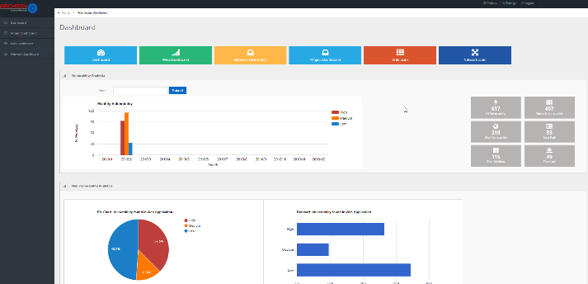







How Does Archery Work ?
v
Burp
v
ZAP
Nmap
Nikto

Slide 4
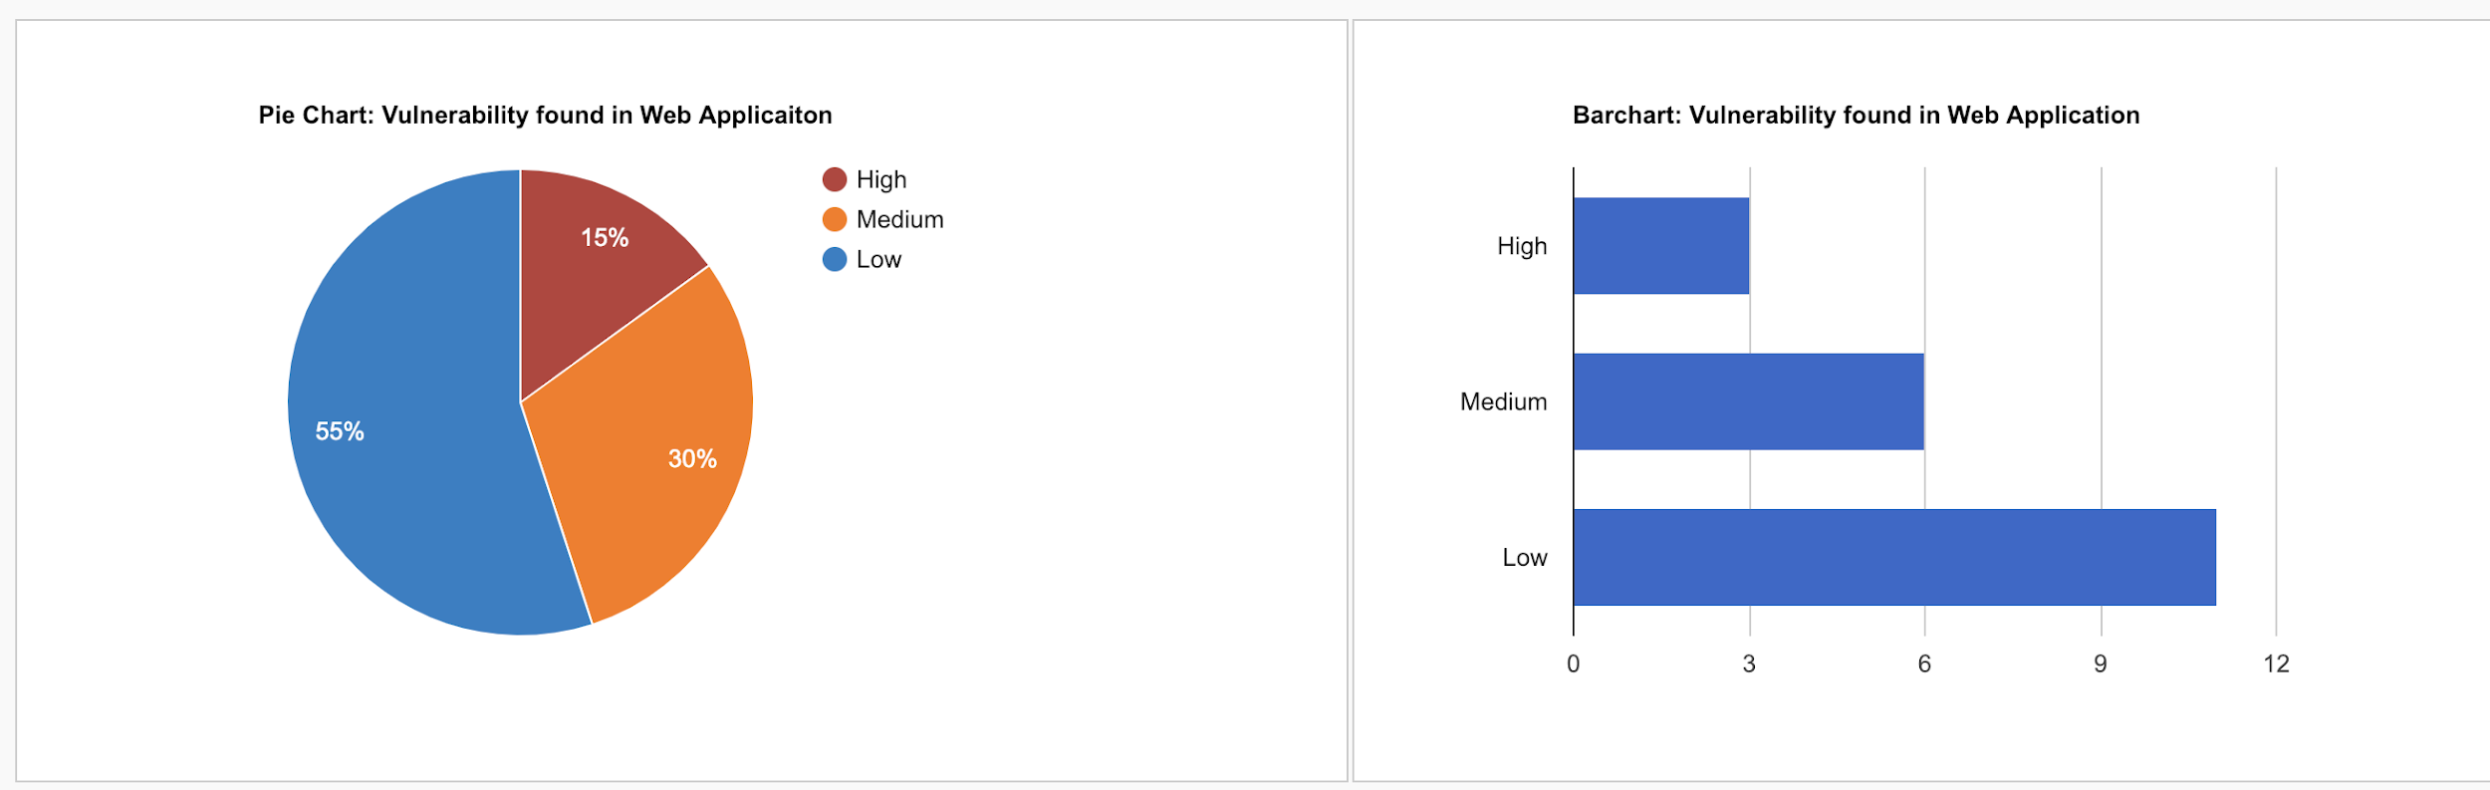


Integrate Archery in your DevSecOps Environment
Dashboard
v
Burp
v
ZAP
Nmap
Nikto

Slide 5
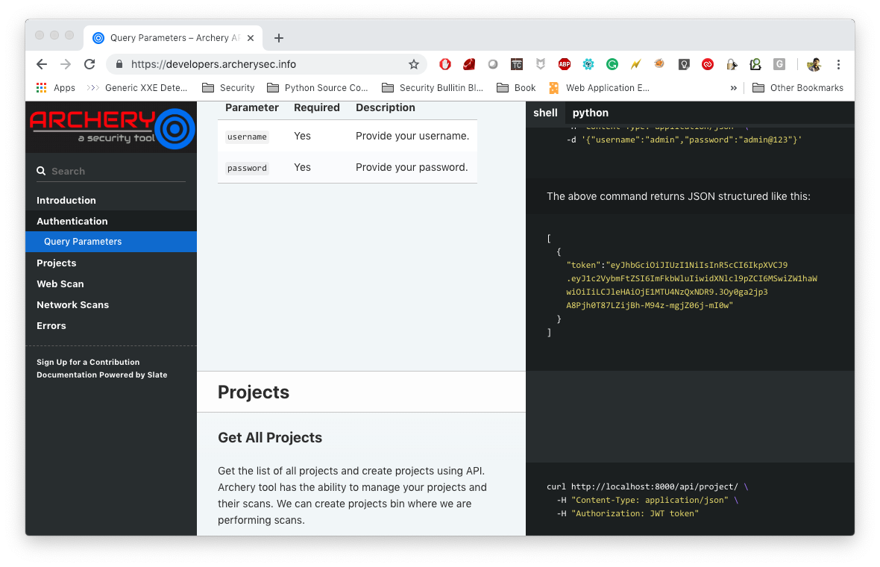
Archery API for Developer

Slide 6
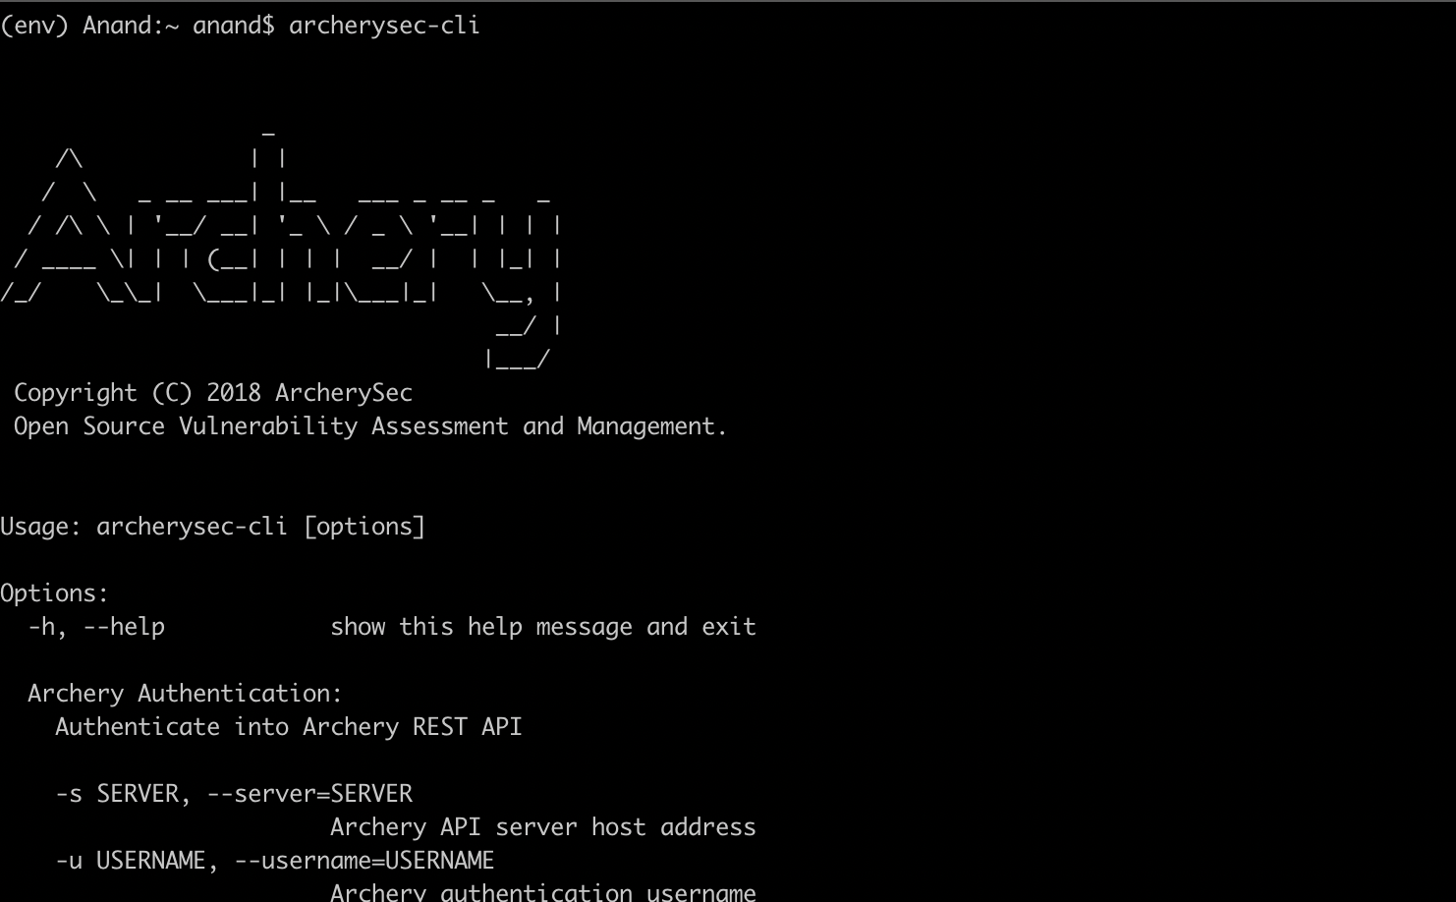
Archery CLI Tool

Slide 7
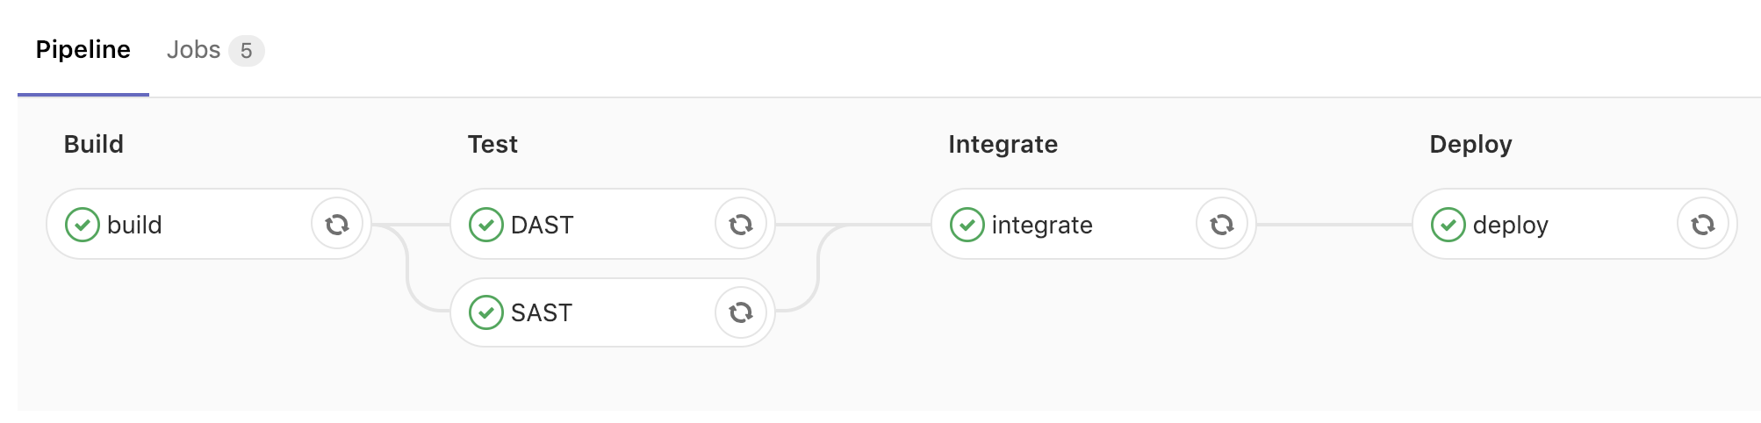
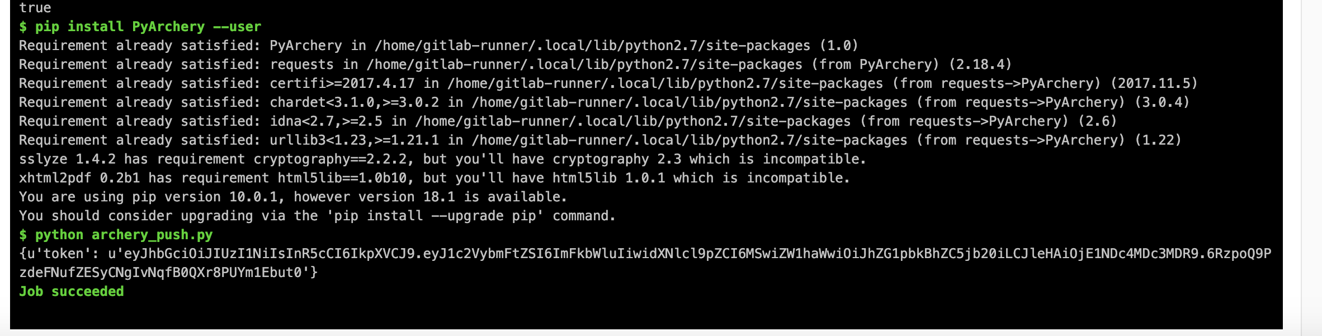

Slide 8
Scanners Plugins
OWASP ZAP
Burp Scan
Arachni
Nmap
Nikto
Nmap + Vulners
OpenVAS

Slide 9
Scanners Report Parsers
OWASP ZAP (XML)
Burp (XML)
Arachni (XML)
Netsparker (XML)
Webinspect (XML)
Acunetix (XML)
OpenVAS (XML)
Nessus (XML)
Bandit (Json)
Retirejs (Json)
Dependency Check (XML)
FindBugs (XML)

Slide 10
Scanners Support work in progress.
Varacode (XML)
Trufflehog (json)
Ssllabs (json)
Sourceclear (json)
Qualys Web app (xml)
Qualys (xml)
Nsp (json)
Npm audit (json)
Nexpose (xml)
Brakeman (json)
Appspider
Gosec (json)
Crashtest_security (xml)
Contrast (xml)
Clair (json)
Checkmarx (xml)

Slide 11
How to Contribute ?
Test Archery Tool
Write scanners plugin or suggest us scanner support.
Use / Promote / write about the tool.
Report issue & feedback @ https://github.com/archerysec/archerysec/issues

Slide 12
Documentation
http://www.archerysec.info
https://archerysec.github.io/archerysec/
https://archerysec.github.io/archerysecapi/

Slide 13
Contact
Twitter - https://twitter.com/archerysec
Facebook - https://www.facebook.com/ArcherySec/
GitHub - https://github.com/archerysec/

Slide 14
QUESTIONS ? ?

